Slide 1
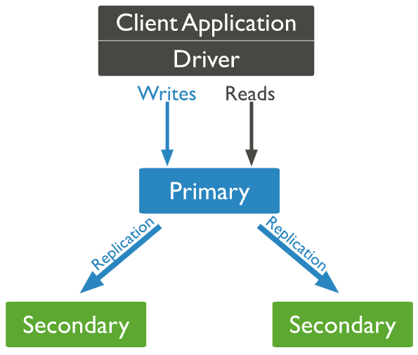

How Setup Single Node Replica Set in MongoDB?
MongoDB achieves replication by the use of replica set. A replica set is a group of mongod instances that host the same data set. In a replica, one node is primary node that receives all write operations. All other instances, such as secondaries, apply operations from the primary so that they have the same data set. Replica set can have only one primary node.
Oplog
Single Node ReplicaSet
3 Nodes ReplicaSet
Primary
Primary
Secondary1
Secondary2

Slide 2
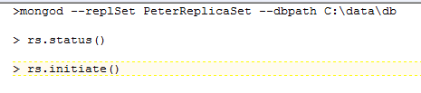
How Setup Single Node Replica Set in MongoDB?

